Slide 1

PG-DAC March 2023 C-DAC HYDERABAD

Slide 2
E-COMMERCE WEBSITE
Guided By - : Ms. Sonia Devi
Team:
Sr. No.2 | Name | PRN
1 | Amruta Laxmikant Khandare | 230350320047
2 | Rohit Sharadkumar Khot | 230350320048
3 | Kiran Tryambak Bhaske | 230350320049
4 | Onkar Ashok Kulkarni | 230350320052
5 | Neha Arun Kumavat | 230350320053
6 | Madhur Prabhakar Nandgaye | 230350320055

Slide 3
INTRODUCTION
Welcome to our presentation on building a robust and feature-rich e-commerce platform.
We'll dive into the various aspects of this project, from its features to the technical details that power it.

Slide 4
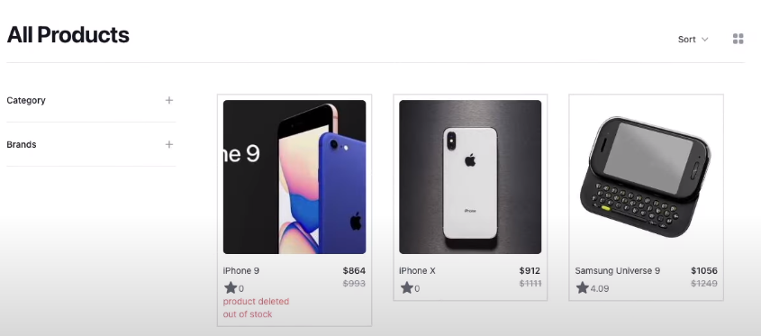
Building a Feature-Rich E-commerce Platform :

Slide 5
Objective:
PROJECT OVERVIEW
Our project aims to create a comprehensive e-commerce platform with a focus on user experience, security, and administrative control.
This platform will enable customers to explore products, make secure payments, and manage their orders seamlessly.

Slide 6
KEY FEATURES
Basic E-commerce Features: Product lists, product details, cart, and checkout processes.
Payment Options: Secure card payments and cash-on-delivery.
Admin Panel: Order and product management for administrators.
Advanced User Interaction: Sorting, filtering, and pagination for an enhanced shopping experience.
Authentication: User registration, login, and profile management.
Email Notifications: Order and password reset emails for improved communication.
User Profile: User profiles and order history for a personalized experience.

Slide 7
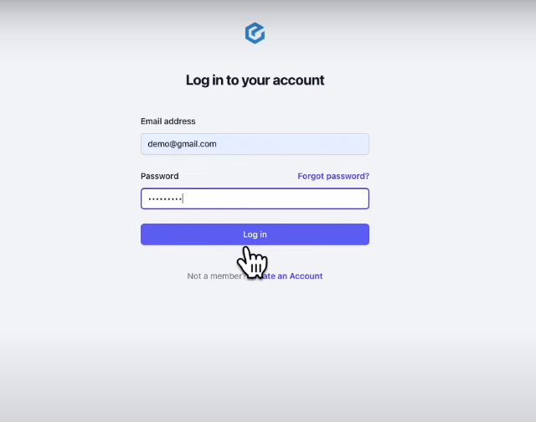
Login:

Slide 8
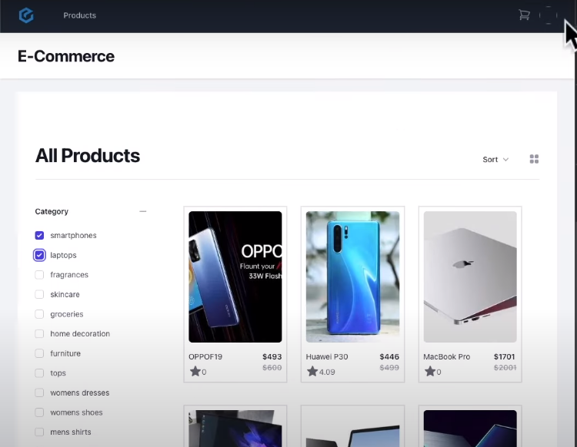
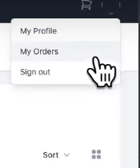
Product list:

Slide 9
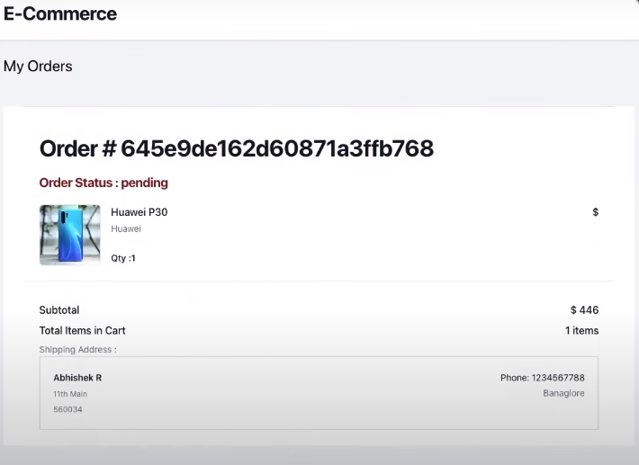
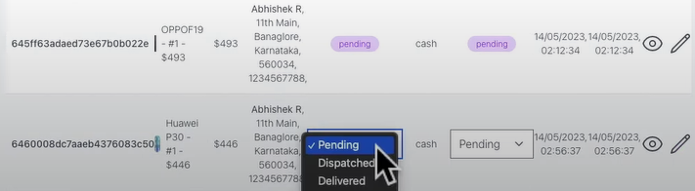
Order Page:

Slide 10
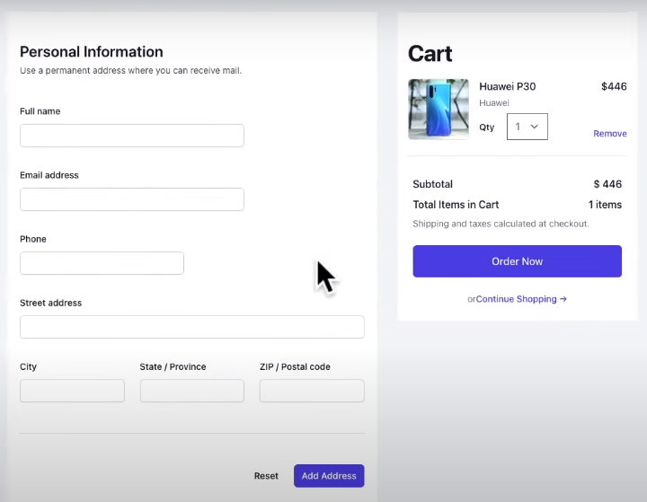
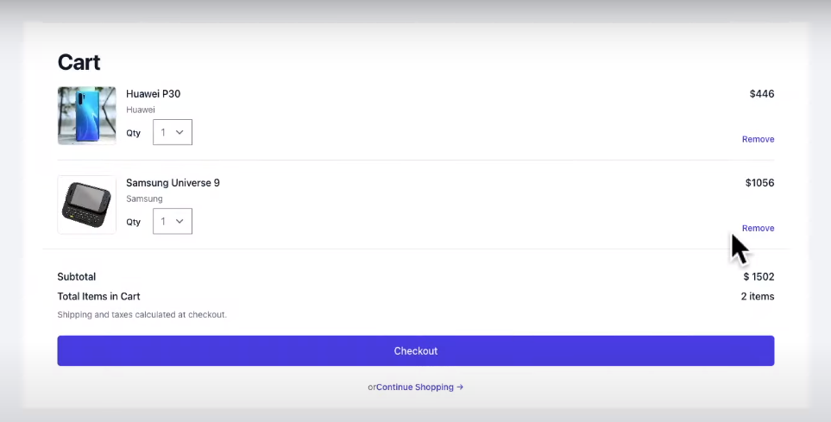
Checkout Page:

Slide 11
TECHNICAL STACK
Front-End: Built using React 18 with Tailwind CSS for modern and responsive user interfaces.
State Management: Utilizes Redux Toolkit with Async Thunk for efficient state management.
Routing: Implements React Router v6 for smooth navigation between different sections.
Back-End: REST API powered by Express and MongoDB for efficient data handling.
Authentication: Incorporates Passport JS strategies for user authentication and session management.
Payments: Integrates Stripe's PaymentIntent API for secure online transactions.
Deployment: Hosted on Vercel for easy and reliable server deployment.

Slide 12
USER EXPERIENCE
Product Exploration: Users can browse through product listings, view details, and select items.
Seamless Checkout: A user-friendly checkout process that supports secure card payments and cash-on-delivery.
User Profiles: Registered users can manage their profiles, including personal information and order history.
Order Notifications: Automated order confirmation emails for a smooth post-purchase experience.

Slide 13
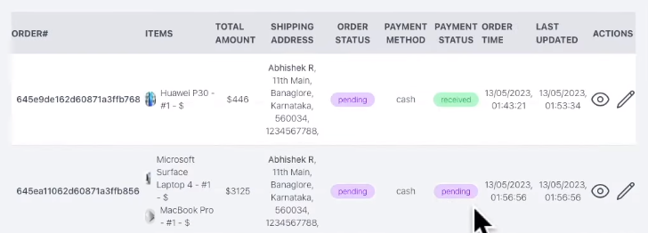
ADMINISTRATIVE CONTROL
Admin Panel: Administrators can manage orders, including updates and status changes.
Product Management: Admins have the ability to add, edit, and remove products.
Real-time Insights: Access to data about products, orders, and customer interactions for informed decisions.
Admin Panel:

Slide 14
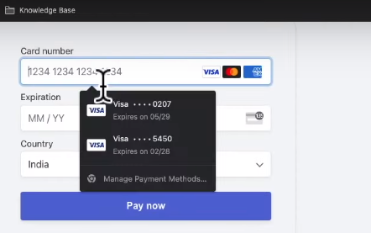
SECURITY & PAYMENTS
User Authentication: Passport JS strategies ensure secure and reliable user authentication.
Secure Payments: Stripe's PaymentIntent API guarantees secure handling of online payments.
Data Protection: User data, passwords, and payment details are stored with the utmost security in mind.

Slide 15
NEXT STEPS
Collaborate with development teams to start implementing the project.
Design and develop each module meticulously, ensuring seamless integration and functionality.
Rigorous testing to identify and address any bugs or issues.
Gradually roll out features, conduct user testing, and gather feedback.
Once fully functional, deploy the platform and ensure a smooth launch.

Slide 16
CONCLUSION
Our comprehensive e-commerce platform is designed to provide users with an exceptional shopping experience.
By leveraging modern technologies and focusing on user needs, security, and administrative control, we aim to build a successful and sustainable solution.

